Slide 1
Take it to the next level at
AJ2022
Starter Information Pack for Scout Leaders
Released September 2020

Slide 2
Introduction to AJ2022
When Mon 3 Jan – Thu 13 Jan 2022
Where Elmore Field Day site
Campaspe Shire, Victoria
Theme Take it to the next level
Family Day Saturday 8 January

Slide 3
Introduction to AJ2022
If you’re in NSW, you can find out about AJ2022:
Website:
https://www.nsw.scouts.com.au/aj2022/
Facebook:
https://www.facebook.com/NSWContingentAJ2022/
Instagram:
https://www.instagram.com/nswcontingentaj2022/
Email:
nsw.contingent@nsw.scouts.com.au

Slide 4
What to expect
Ten days packed with adventure, excitement and fun
The Jamboree site is a small city, housing & feeding thousands of people
It has its own shopping centre, radio station, daily newspaper, medical centre, bus station and arena
Scouts come from all over the world to have an experience of a lifetime

Slide 5
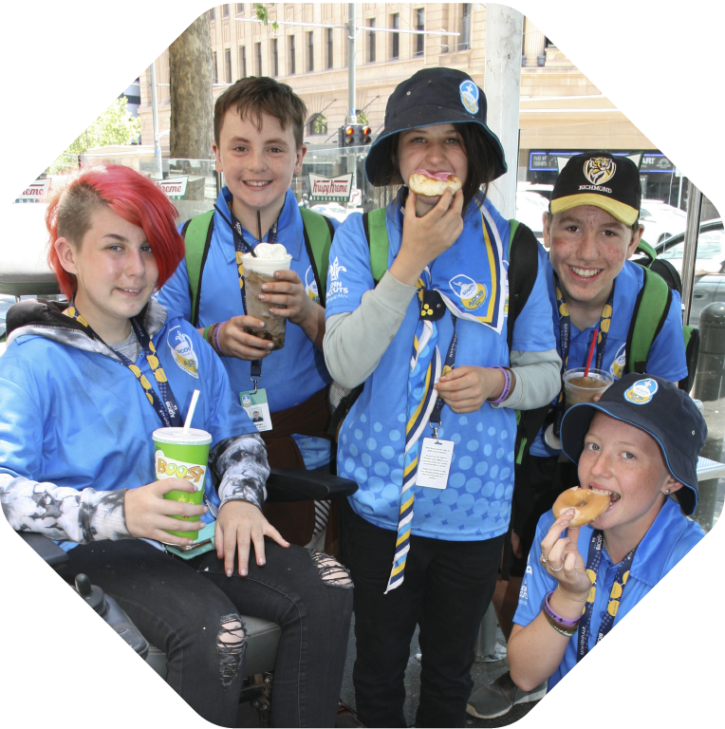
What to expect
Past Jamborees have included
Circus training
Flying fox races
Obstacle courses
Mud
Snake charming
Abseiling
Swimming
Zorbing
High ropes
Tattoos
Laser tag
Waterslides
Nerf wars
Visits to nearby events and parks

Slide 6
What to expect
In the evenings, there is plenty of entertainment available including:
Acting
Dancing
Music
Well-known bands and comedians on the main stage
There is something exciting to do every day. And there’s something for everyone. You don’t have to participate in all the events, but you’ll probably be persuaded to try!

Slide 7
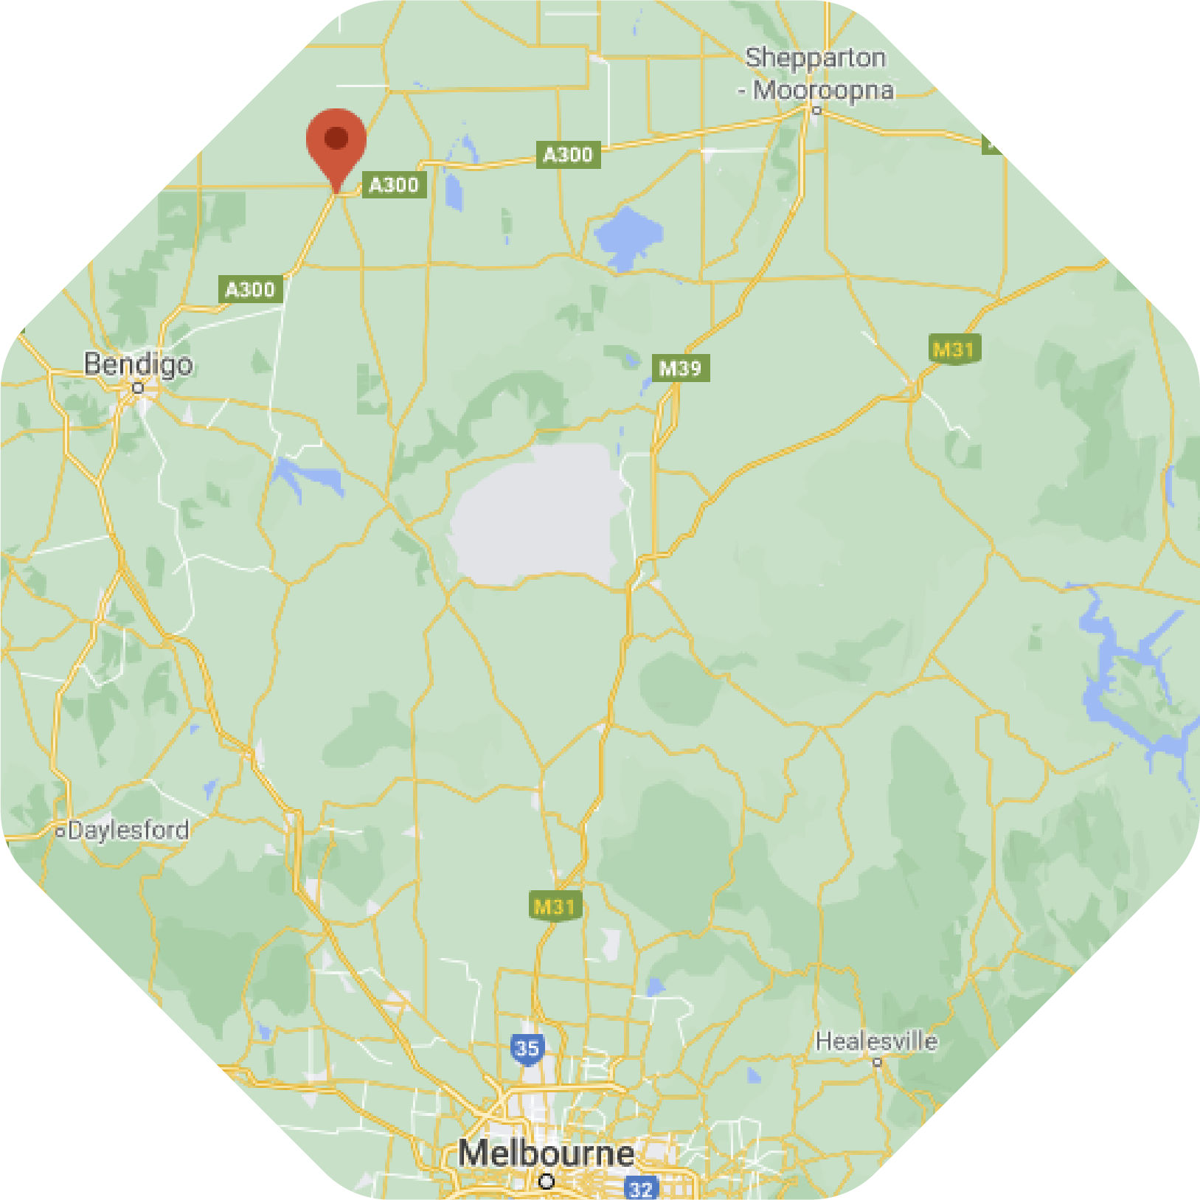
Getting there - Getting where?
Elmore is a small town (population 776), north of Bendigo on the Campaspe River.
The Elmore Field Days site is 154 hectares, including buildings and an airstrip.
Elmore hosted the 21st Australian Jamboree in January 2007:
It’s an established site
There’s lots of useful infrastructure
It has abundant water
It is central to a great range of activities
It’s affordable
There’s good camping on flat, green paddocks
Transport will be arranged by the NSW Contingent to the site.

Slide 8
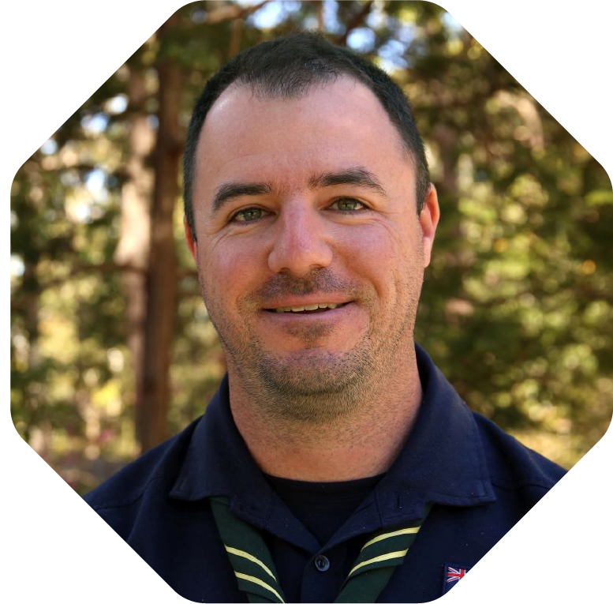
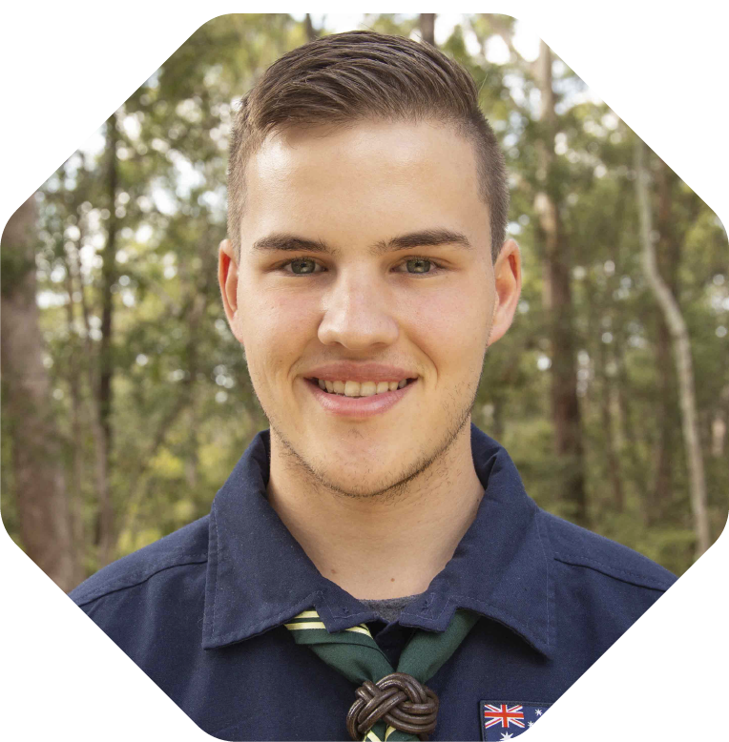
Meet the NSW Contingent Team
Chris Buggie,
NSW Contingent Leader
Been in Scouts for 22 years
Attended 6 Jamborees
Currently a State Commissioner
Contingent Directors
Tracey Stopps, Director of Operations
Anthea Cudworth, Director of Marketing & Media
David Roche, Director of Sites and Services
Steve Tufts, Director of Logistics and Transport
Anthony Pritchard, Director of Health, Safety & Wellbeing
Mitchell Stubbs,
Deputy NSW Contingent Leader
Been in Scouts for 14 years
Attended 2 Jamborees
Currently a State Commissioner
You can contact the team at
nsw.contingent@nsw.scouts.com.au

Slide 9
What’s different this time?
Expressions of Interest before opening Applications
Total cost of attending will be the same or less than last year
More offsite activities including overnight events
All merchandise created centrally to ensure high quality, sustainable credentials are maintained
The Youth Program will be embedded throughout the event
Much smaller Contingent Headquarters

Slide 10
The Timetable
Mid-2020 AJ2022 NSW Contingent website launched
Mid-September AJ2022 NSW Contingent social media pages launched
End September NSW Leader News and Starter info pack released
End September National e-news on AJ2022
SCHOOL HOLIDAYS

Slide 11
The Timetable
Term 4 starts Information sent to Groups to build Expressions of Interest
Oct & Nov Information sent to Groups to promote AJ2022
By end November Expressions of Interest must be submitted
Soon after… Applications open
SUMMER HOLIDAYS

Slide 12
To help you market and promote AJ2022
GENERAL MATERIALS
Information Pack for Leaders
Letter for parents
RUNNING A LAUNCH EVENT
A guide on how to run a great launch
An invitation template
A presentation for the launch
A video
Posters for your Scout Hall
Questions & Answers
PROMOTION TOOLS
The Brand Guide book
Social media tiles
Fundraising charts
Make sure to use the NSW Contingent Logo

Slide 13
Who can attend
SCOUTS
You are a current registered Scout youth member at the time of application and through until at least 14 January 2022.
QUALIFICATIONS
You have met the requirements, before 31 October 2021, for either:
Program Essentials Milestone 1, as well as Outdoor Adventure Skills Stage 3 in Bushcraft, Bushwalking, and Camping;
OR the Pioneer Badge
CAMPING
You have completed 10 nights camping in the outdoors with the Unit or Patrol, as a Scout.
Three of those nights must be consecutive.
Camping with your family or school is not included.
WORKING WITH CHILDREN
If you turn 18 years old at any point during the Jamboree, you are treated as an adult and must therefore hold evidence that you meet the NSW legislative requirements to work with children (the Working With Children Check or WWCC).
AGE
You are under the age of 15;
OR You only turn 15 on 4 January 2022 (the Opening Ceremony) or after 4 January 2022.

Slide 14
Who can attend
VENTURER SCOUTS
You are a current registered Venturer Scout youth member at the time of application and through until at least 14 Jan 2022. You have a desire to participate in active community involvement, in this case supporting the Scout section at a major event.
QUALIFICATIONS
You have completed:
Program Essentials Introduction to Section for Venturer Scouts, as well as Outdoor Adventure Skills Stage 3 in each of Bushcraft, Bushwalking, and Camping; OR Venturer Skills Award.
APPROVALS
You have been recommended by your Unit Council as being of excellent character, a good role model to Scouts, and with the skills and abilities to undertake the activity (or other tasks) you have nominated on the application form; you have approval from your Contingent Leader and you have consent from your parent/s or guardian/s
APPROVALS
You have approval from your Scout Unit Council
You have approval from your Contingent Leader
You have consent from your parent/s or guardian/s
AGE
You have turned 15 or older, on or before 3 January 2022 (the day before the Opening Ceremony).
You only turn 18 on 4 January 2022 (the Opening Ceremony) or after 4 January 2022.

Slide 15
Who can attend
ROVER SCOUTS
You are a current registered Rover Scout member at the time of application and through until at least 14 Jan 2022. You have a desire to participate in active community involvement, in this case supporting the Scout section at a major event and you are able to cope with the physical requirements of this event.
QUALIFICATIONS
You have completed:
Program Essentials Introduction to Section for Rover Scouts, as well as Outdoor Adventure Skills Stage 3 in each of Bushcraft, Bushwalking, and Camping; OR Squire Training badge.
You have completed the SAIT compulsory eLearning modules of BCORE and Child Safe & WHS.
APPROVALS
You are recommended by your Unit Council as being of excellent character, a good role model to younger youth members, and with the skills and abilities to undertake the activity (or other tasks) you nominated on the application form plus you have approval from your Contingent Leader
WORKING WITH CHILDREN
You hold evidence that you meet the NSW legislative requirements to work with children (the Working With Children Check or WWCC).
AGE
You have turned 18 or older, on or before 3 January 2022 (the day before the Opening Ceremony).

Slide 16
Who can attend
ADULT LEADERS
You are a current registered adult member of the Scouts NSW branch at the time of application and through until at least 14 Jan 2022.
You are able to cope with the physical requirements of this event.
QUALIFICATIONS
You have completed the SAIT compulsory eLearning modules of BCORE and Child Safe & WHS.
APPROVALS
You are recommended by your Line Manager (e.g. Group Leader, District Commissioner, Region Commissioner)
You have approval from your Contingent Leader
WORKING WITH CHILDREN
You hold evidence that you meet the NSW legislative requirements to work with children (the Working With Children Check or WWCC).

Slide 17
Who can attend
ADULT SUPPORTERS
You are a current registered adult member of the Scouts NSW branch at the time of application and through until at least 14 Jan 2022.
You are able to cope with the physical requirements of this event.
QUALIFICATIONS
You hold a Certificate of Adult membership,
You have completed the SAIT compulsory eLearning modules of BCORE and Child Safe & WHS.
APPROVALS
You are recommended by your Line Manager (e.g. Group Leader, District Commissioner, Region Commissioner)
You have approval from your Contingent Leader
WORKING WITH CHILDREN
You hold evidence that you meet the NSW legislative requirements to work with children (the Working With Children Check or WWCC).

Slide 18
Who can Attend…
On 3 January 2022 | On 4 January 2022 or after (the day of the Opening Ceremony) | You can attend as a…
I will be under 15 | I turn 15 | You can attend as a Scout
I will be 15 or over | I turn 18 | You can attend as a Venturer
I will be 18-25 |  | You can attend as a Rover
I will be 18 or over |  | You can attend as an Adult Leader or Supporter

Slide 19
Don’t Miss out!
Visit https://www.nsw.scouts.com.au/aj2022/ for more info
Can’t find the answer on the website? Contact the Contingent Team at nsw.contingent@nsw.scouts.com.au
Can’t wait to see you at AJ2022!

