Slide 1
Adventurous Activities General Briefing Kenton Jurgs: State Commissioner Adventurous Activities 10 March 2022

Slide 2
Acknowledgement
As Scouts of Australia, we acknowledge Australia’s First Nations Peoples. We acknowledge the Aboriginal and Torres Strait Islander peoples as the Traditional Custodians of this land. We pay our respects to Elders past, present, and emerging. We’re grateful to do our Scouting in this country. We commit to using its resources wisely and developing our understanding of Aboriginal and Torres Strait Islander cultures. We also acknowledge any Aboriginal and Torres Strait Islander Scouts who are part of our movement today.

Slide 3
Agenda
Why change
What’s changing
Challenges
What’s Next
Questions
Our Ask

Slide 4
Why the change?
We are making this change to align us with National Policy (NAAF) and the relevant Industry Standards (AAAS) which in turn help us respond to the outcomes of the SafeWork and our internal investigations into the 2021 abseil accident.
At the moment, we are one of only two Branches that can run every activity on the OAS from Stage 1 to 9. Others are restricted by insurance.
Our prime goals are to:
Keep our Adult and Youth members safe
Preserve our ability to run the depth and breadth of activity we currently can

Slide 5
What is changing?
New Adventurous Activity Hub on the State Web Site
Updated AA Policy and Vertical Procedure and new Core Conduct Procedure introducing an Activity Plan
Clear guidelines on what activities leaders can run with what qualifications
We are giving clear approval rights to Group Leaders for lower-risk activities
New Activity Approval and Notification system replacing WHS-3 and E1 Pt III completely for AA
New system for capturing requests for qualifications
Full adoption of the NAAF qualifications framework

Slide 6
Key Change #1 – a Website
A single point of entry for Adventurous Activities
Tiles to guide a member to typical requirements
Guided process for planning an Adventurous Activity and Getting Qualified, including links to tools, procedures and support materials
Let’s have a look…

Slide 7
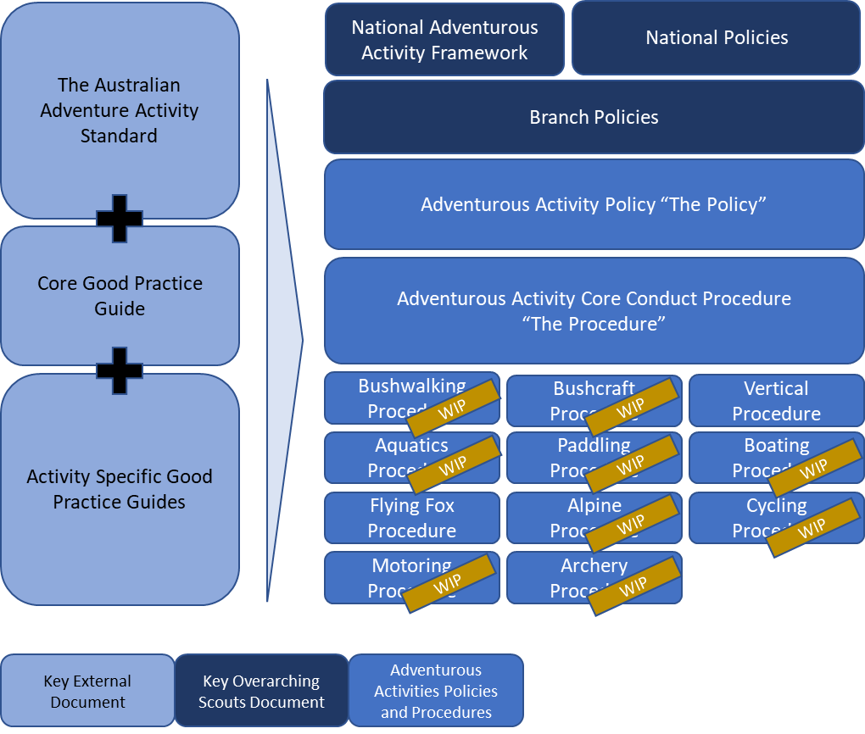
Key Change #2 – updated Policy and Procedures
Policies and Procedures mirror the Australian Adventurous Activity Standard (AAAS)
Following the AAAS is a requirement in the NAAF and was a major recommendation from SafeWork
The Core Conduct Procedure represents our implementation of the Good Practice Guide
All documents follow the same AAAS structure and build on each other
2022 will see us complete all remaining procedures

Slide 8
Key Change #3 – the Activity Plan
Template based on recommendations from the AAAS and supported by direction in the Core Conduct Procedure
Captures the key concerns for an Adventurous Activity and has a particular focus on:
The purpose of an activity
Safety and Emergency Management (prior elements of the E1 Pt III)
Content can be easily modified to suit activities with different complexity and risk
High reusability from activity to activity

Slide 9
Key Change #4 – “What Activities Can I Run?”
Provides direction on qualification a Leader or Rover has to have to run an activity based on specific Conditions, Supervision Method and Participant Qualifications.
Based on the NAAF and AAAS and was a response to a direction from SafeWork (especially around Participant Qualifications)
Explained in the Core Conduct Procedure
Delegates approval to Group Leaders where possible

Slide 10
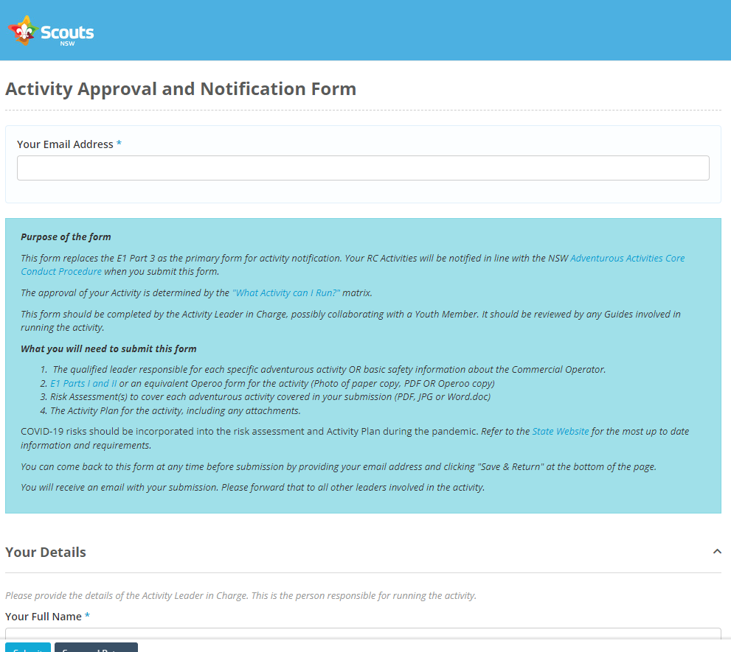
Key Change #5 – Activity Approval and Notification System (ANS)
Single online form for requesting approval of an Adventurous Activity and notifying emergency contacts and senior region and state stakeholders
Has an offline Group Leader approval that must happen before submission
Completely eliminates paper documentation if Operoo is used in a Group – no requirement for signatures
Captures activity documents allowing us to build a library of activities
Gives us data on what we are running across the State

Slide 11
Key Change #6 – Qualifications
Qualifications based on the NAAF with six levels:
Safe Participant
Trained Participant
Assistant Guide
Guide
Activity Specialist
Award of SP and TP is by an Appointed Guide
Award of AG though AS requires assessment by SAIT of competence
All qualifications require you to have a logbook
Following the Core Conduct Procedure gives you the evidence for qualification
Single online form for requesting qualification

Slide 12
Challenges
Our biggest challenge is going to be compliance
Someone either does not use the system or does not follow the procedures and a Member is avoidably hurt. We cannot allow this to happen
The other challenges are the capability of Group Leaders to review Adventurous Activity plans and risk assessments and for Leaders and Rovers to do the level of planning we are seeking

Slide 13
We haven’t finished
Rewriting Procedures for all activity disciplines
Completing Standard Risk Assessments and a tool to support risk
Helping everyone update their qualifications and skills
Improving access to activities for all members across the State

Slide 14
Questions?
You chance to ask any questions you may have
Type them into the chat
We wont get to them all

Slide 15
Our Ask
Use the procedures and systems and give us feedback to improve them: adventurousactivity@nsw.scouts.com.au
Reach out if you have time to help with areas we haven’t completed
Respect that we are all volunteers and are working hard to achieve a better outcome for the organisation and its’ members
Be patient as it will take time to fix our current challenges

Slide 16
Detailed List of Changes
We will fully adopt the NAAF and the AAAS and have implemented the AAAS in the Core Conduct Procedure.
Leaders will be qualified using the NAAF ScoutSkills which is in turn, based on the AQF Outdoor Leadership qualifications.
Guides must be assessed by SAIT against the AQF Outdoor Leadership qualifications and be appointed as State AA Guides.
Qualifications and appointments determine what activities, for what level of participant competence, in what conditions, using what supervision method a Leader may run an AA.
Essentially, risk determines what qualifications are required and the qualifications mapping are codified in the Core Conduct Procedure “What Activities I can Run?” matrix.
Activity Planning is enhanced using approaches from the AAAS. This along with a Risk Assessment is mandatory for all AA.
Risk Assessments are based on a Standard Risk Assessment which captures the typical risks of an activity. This is currently completed for Abseiling and in process for the rest of the activity disciplines.
Controls are captured in Core Conduct and in discipline Procedures. Currently, Vertical is published and well progressed for Alpine and Bushwalking.
All AA Activity Plans and Risk Assessments must be reviewed and approved using an electronic approval and notification system. This system instantiates the Core Conduct Procedure. All relevant persons are notified by email of the activity. The E1 Part III is replaced. WHS-3 is retired.
We gain awareness of what AA is being run at all times. We harvest activity and risk planning and have a closed improvement cycle.
Activity conduct across the State is standardised and Leaders can access all materials and supporting systems through a hub on the State Website.

