Slide 1
Introduction to Scouts
Presented by <name> from <Scout Group>

Slide 2
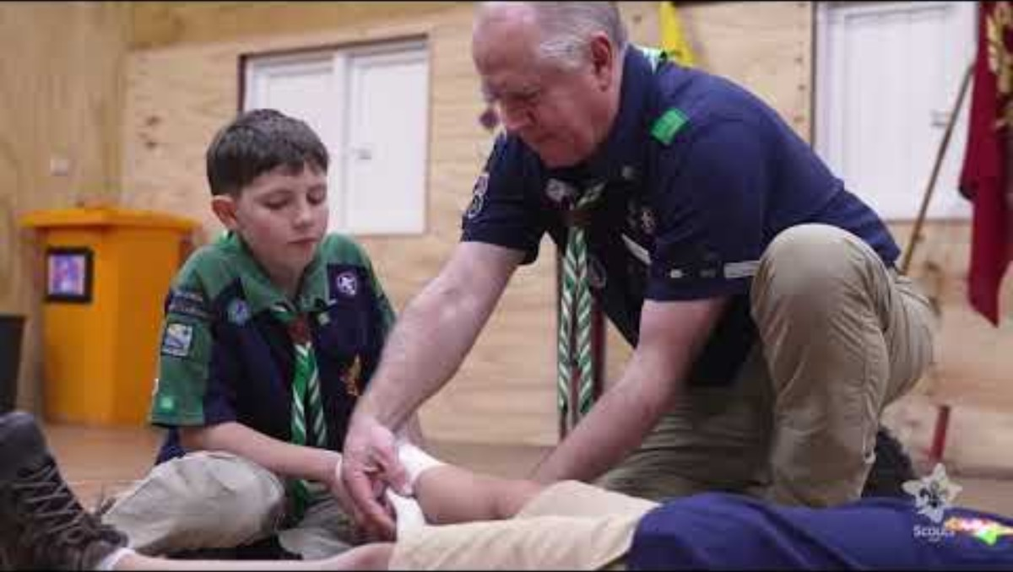
Video

Slide 3
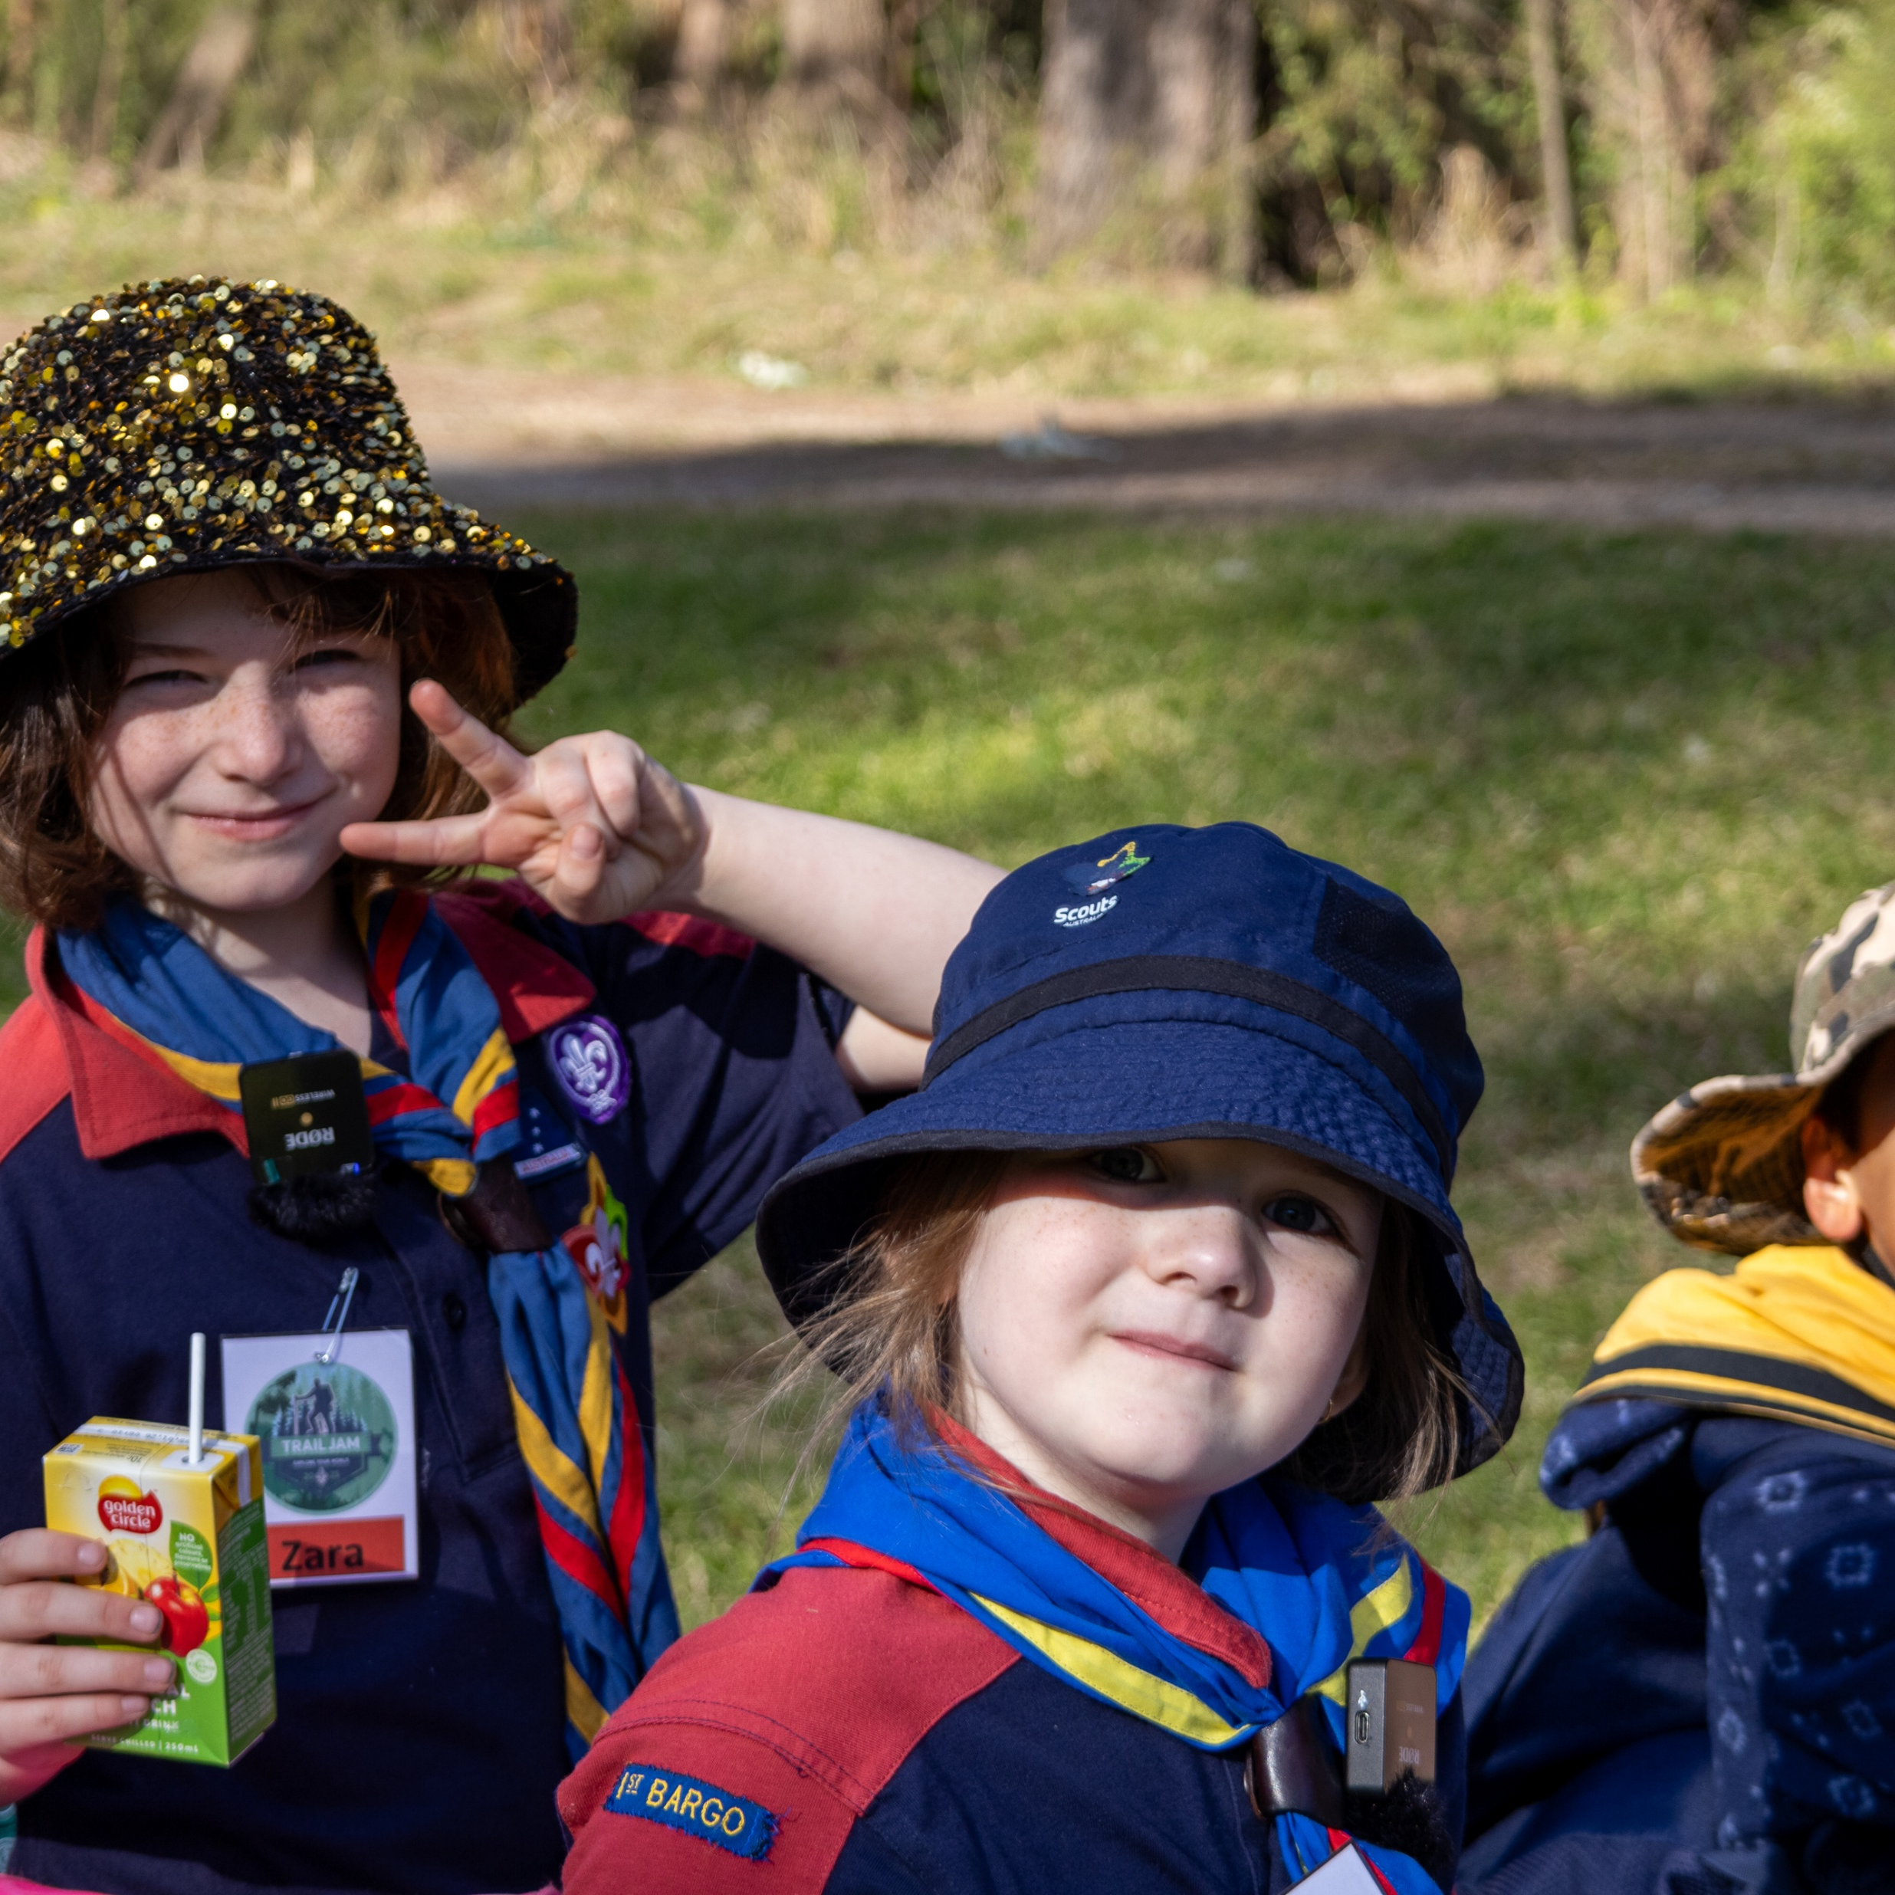
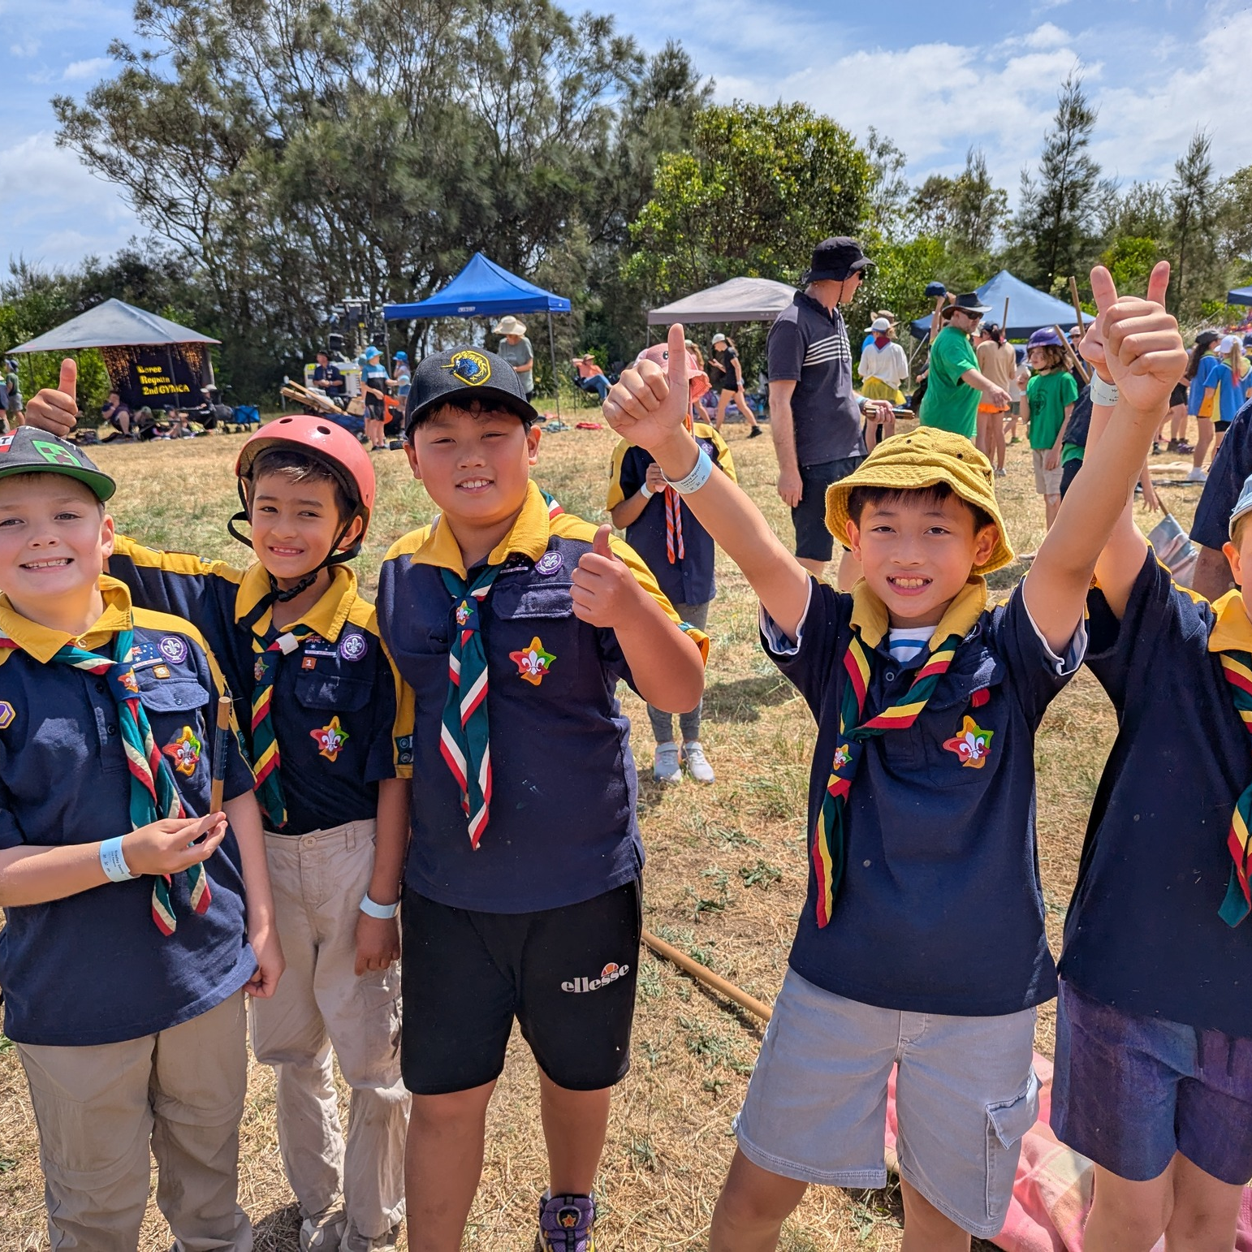
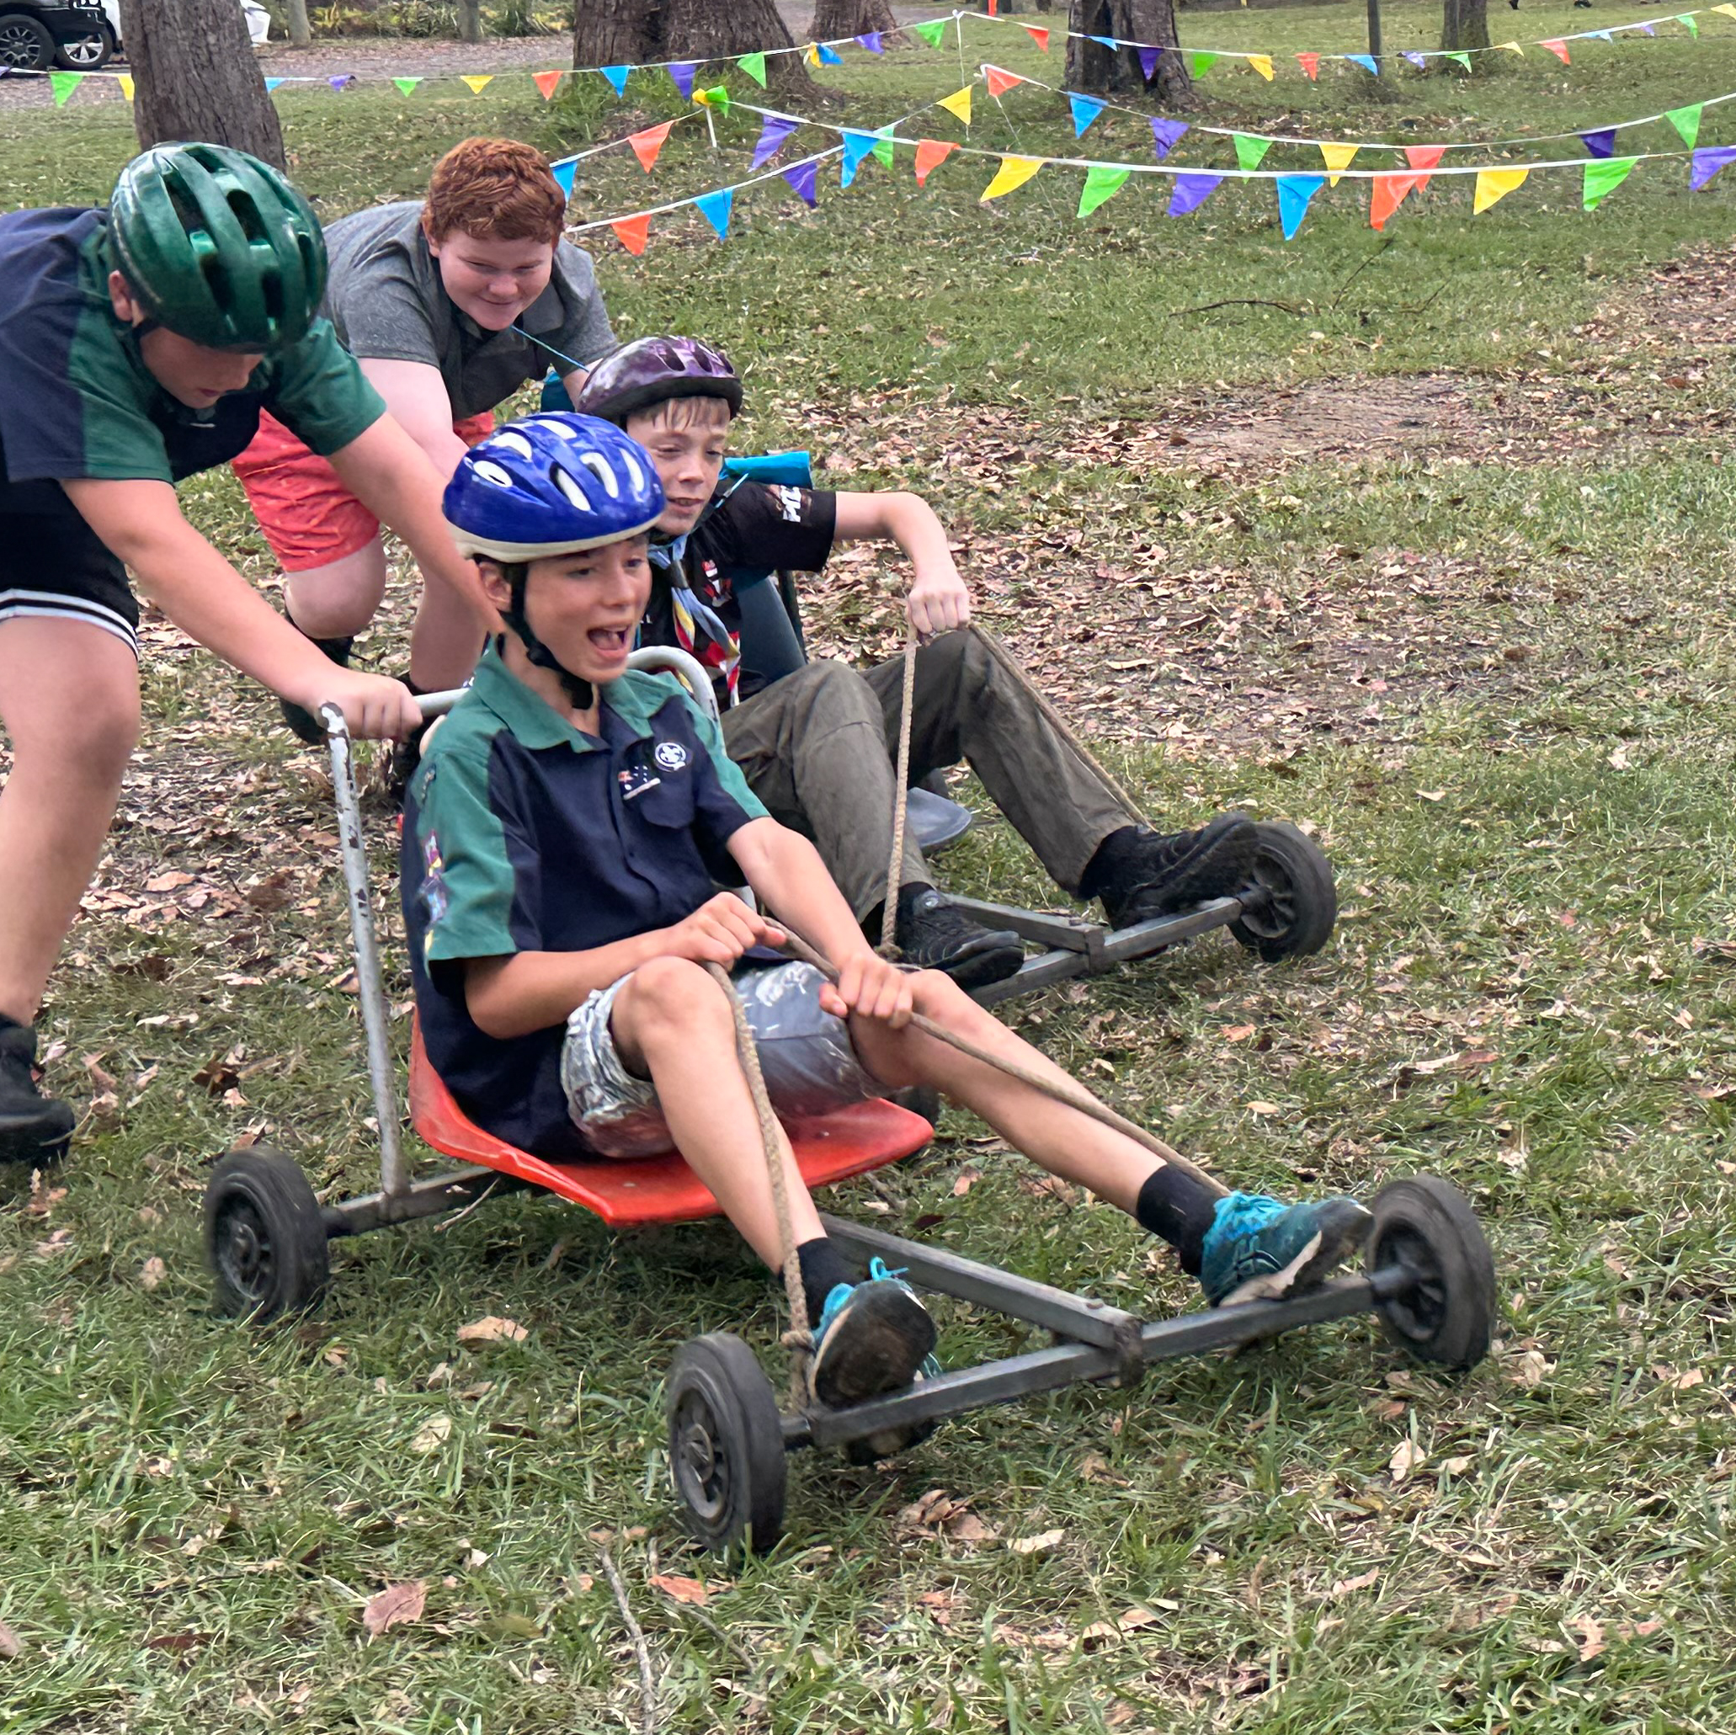
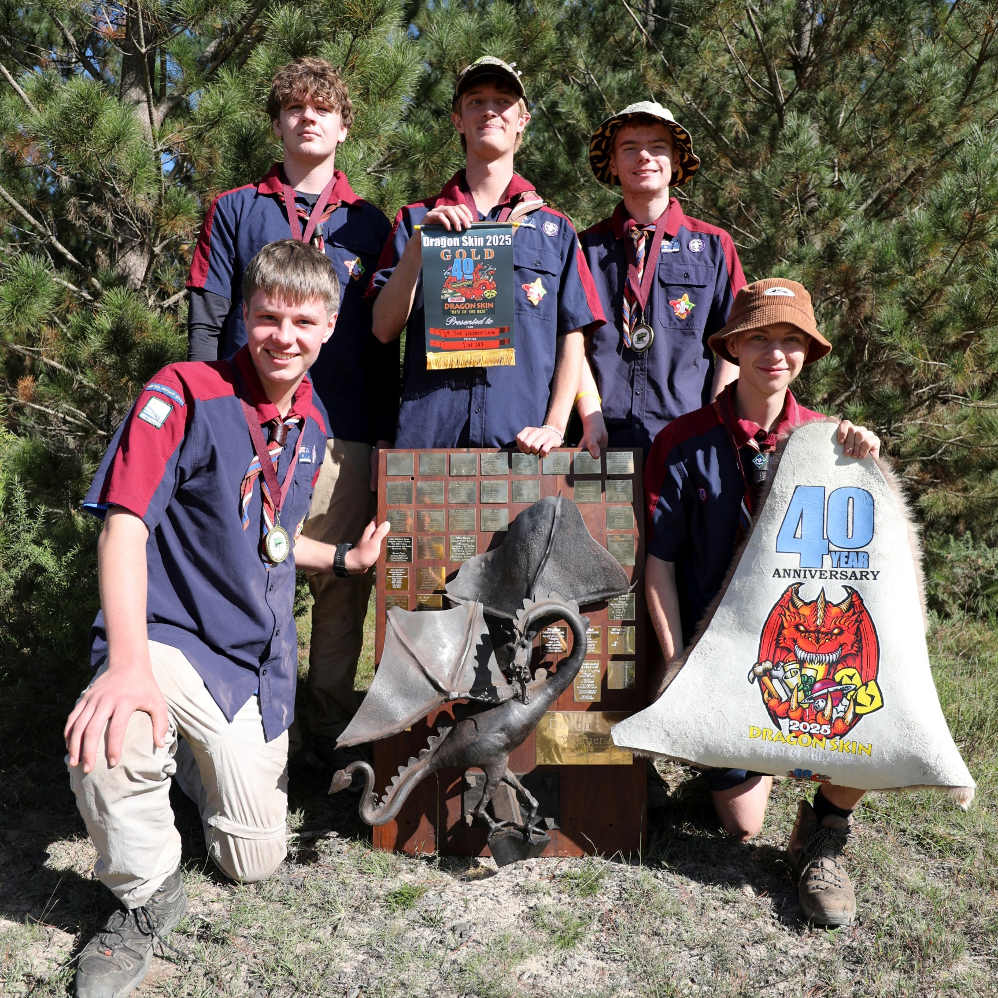
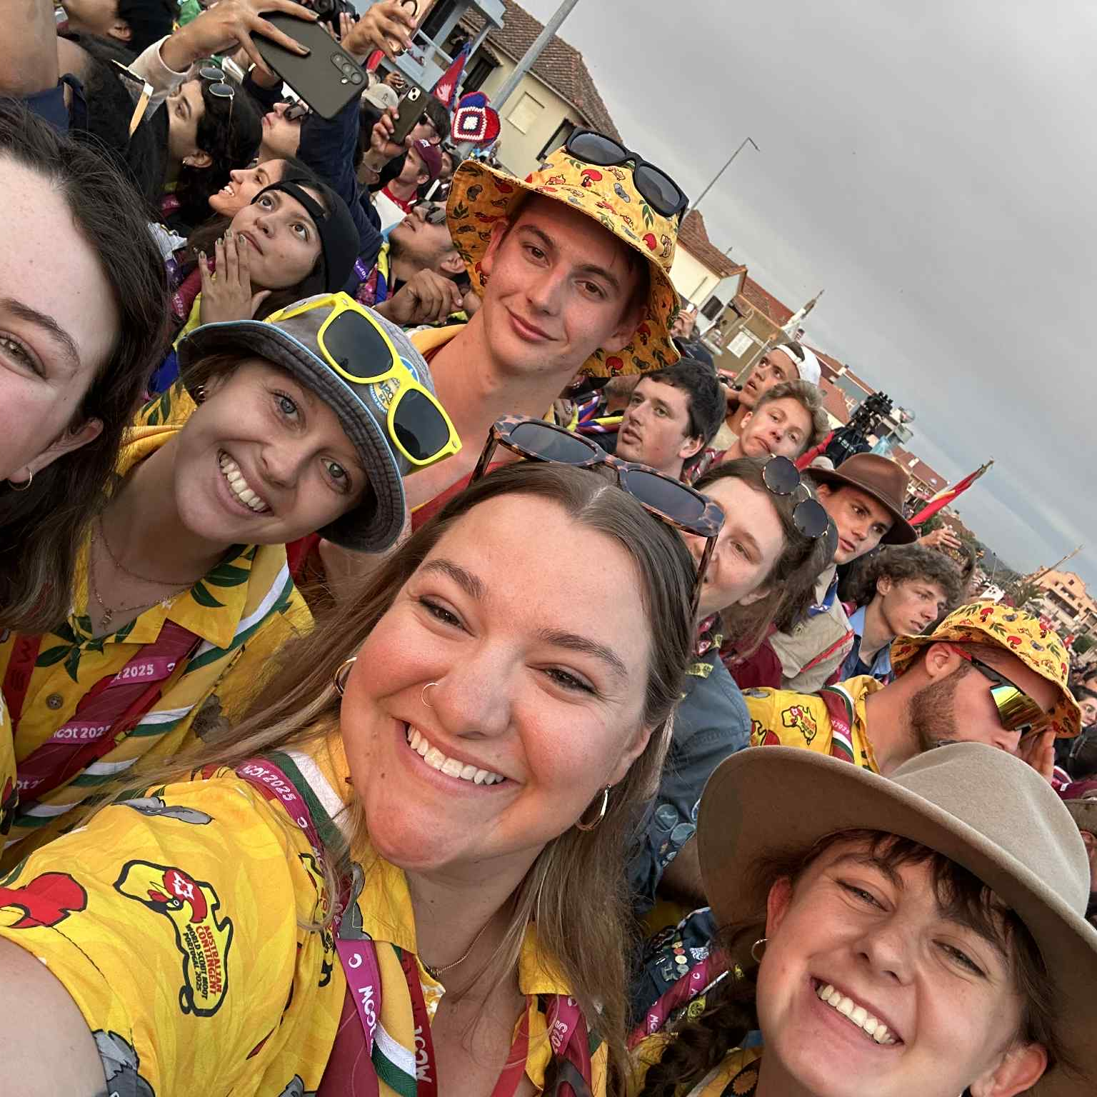





Who are Scouts?
ages 5-8
ages 8-11
ages 11-14
ages 14-17
ages 18-25
Scouts is for boys and girls of all ages, from 5-25. Try a range of adventurous activities like bushwalking, camping, paddling, cycling, climbing and more, as well as special interests such as performing arts, STEM or environmental projects. Learn life skills such as first aid, camp cooking, leadership, and more.
We are adventurous. We are leaders. We are confident. We try new things. We make new friends. We have fun.

Slide 4
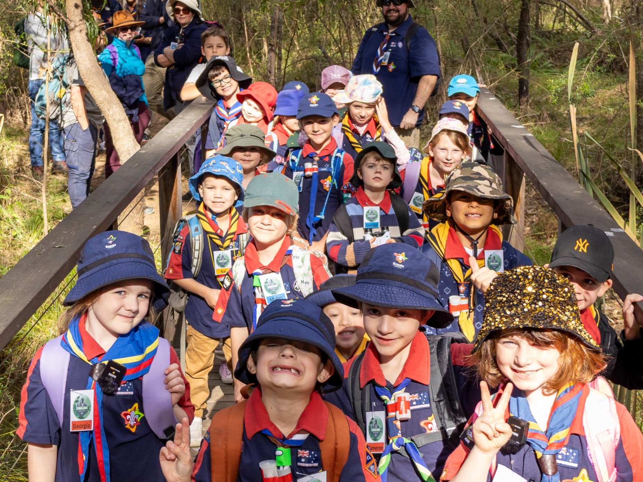

Joey Scouts
Joey Scouts is the first section of Scouts and is for young people aged 5-8.
The Joey Scout section focuses on fun and friendship and is a gentle introduction to a world of adventure.
Joey Scouts might try things such as:
Their first bushwalk or camping trip
Try cooking over a campfire or sing campfire songs
Investigate STEM projects
Learning simple first aid skills
Other games and activities
Joey Scouts form small teams called a Patrol. Working together in your Patrol, you will discover lots of different, fun, exciting and challenging adventures outdoors.
<GROUP NAME> JOEY SCOUTS
TUESDAY 5.30PM-6.30PM
GROUP SCOUT HALL
OUR LEADERS ARE
GALAH (KATE)
QUOKKA (TOM)
WALLABY (SARAH)
Notes:
We would recommend you encourage a current Joey Scout to stand up and talk about their own experiences. Example talking points below:
Hi, In Joey scouts we have boys and girls aged 5-7 and we meet on Wednesdays at 4pm for one hour.
On afternoons and weekends we go bushwalking, camping, water activities, campfires, cooking, games, and meet up with other Joeys. etc.
Last Wednesday we went exploring on a bushwalk in the local park.

Slide 5
Add photos from your own group or unit here

Slide 6
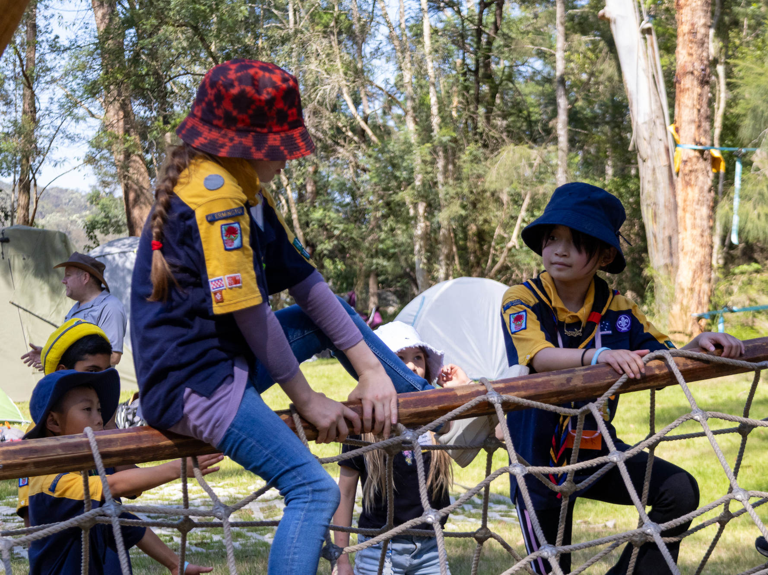

Cub Scouts
Cub Scouts continues the journey and
is for young people aged 8–11.
The Cub Scout section focuses on exploring the outdoors, setting challenges and encountering new experiences!
Cub Scouts might try things such as:
Go on camps
Go on bushwalks, bike trips, or other adventures
Try something new like canoeing or rockclimbing
Get involved in planning and leadership
Make new friends
Cub Scouts form small teams called a Patrol. Working together in your Patrol, you will discover lots of different, fun, exciting and challenging adventures outdoors.
<GROUP NAME> CUB SCOUTS
WEDNESDAY 6.30-8PM
GROUP SCOUT HALL
OUR LEADERS ARE
BALOO (STACEY)
SMOKEY (BLAKE)
HATHI (ALAN)
Notes:
We would recommend you encourage a current Cub Scout to stand up and talk about their own experiences. Example talking points below:
Hi, in Cubs we have boys and girls aged 8-10 yo and meet on Tuesday nights at 6.30. They also suggest and plan some of the following adventures.
Local hikes in the bushlands, camping, cooking damper on and open fire, indoor and outdoor games, what to do when lost in the bush, bike rides, snow trips, flying at our air base and 1st aid to fix all the cuts and scratches.
At the end of the year we are joining 4000 other cubs from NSW for a 5 day camp with 50 different activities.
Boys and Girls meet on Tuesdays at 6.30 and we are inviting you and some friends to try scouting

Slide 7
Add photos from your own group or unit here

Slide 8
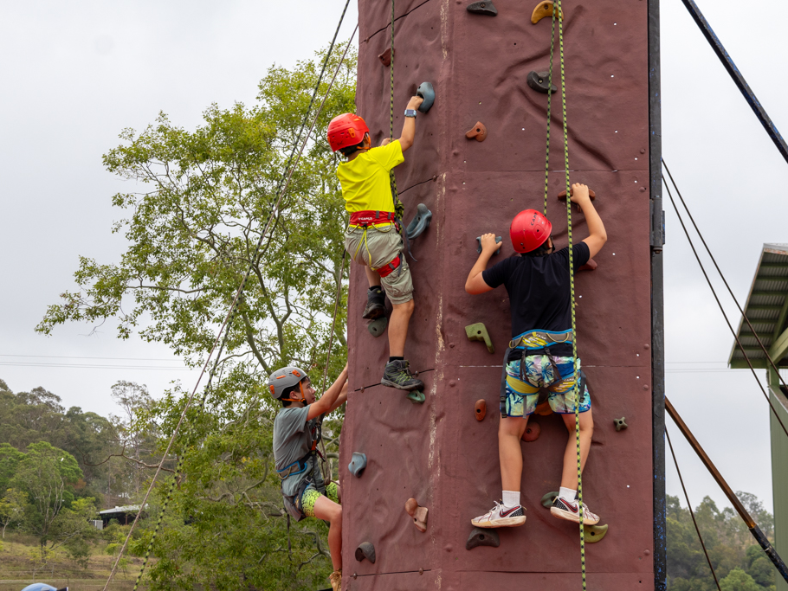
Scouts
Scouts is for young people aged 11–14 years. Scouts develop more complex outdoor skills in a fun and active environment.
The Scouts section offers an amazing variety of activities designed to teach important life skills to get Scouts social and active! Scouts can:
Go on bigger camps and meet people from other regions or states
Go on longer (sometimes overnight) bushwalks, bike trips, or other adventures
Develop confidence by facing challenges and trying something new
Get involved in planning and leadership
Work towards your Australian Scout Award or Duke of Ed
Scouts, as a section, focuses on allowing young people to develop their confidence and teaches them how to work as part of a team.
<GROUP NAME> SCOUTS
FRIDAY 7-9PM
GROUP SCOUT HALL
OUR LEADERS ARE
SKIP (MATT)
DIESEL (ROBBIE)
IKKI (HAYLEY)
Notes:
We would recommend you encourage a current Scout to stand up and talk about their own experiences. Example talking points below:
Hi, in scouts we have boys and girls aged 11-14 yo who meet on Thursday nights at 6.30pm and at weekends,
They are selecting and planning their own adventures.
2 and 3 day camps where you select your menu, buy the food, cook the meals, and camp with mates for a few days. Plan and prep for a 2 day hike, canoeing, sailing, build a raft on the lake, cooking,
Coming up soon the scouts are camping at the local Dam, canoeing, rock climbing. Also hiking with 1000 other scouts in the Southern Highlands, leaning how to build electronic beepers, treasure hunt in the local bushland.
Also, we have programs where you help to plan & run the activities
Boys and Girls meet on Thursdays at 6.30 and we are inviting you and some friends to try scouting.

Slide 9
Add photos from your own group or unit here

Slide 10
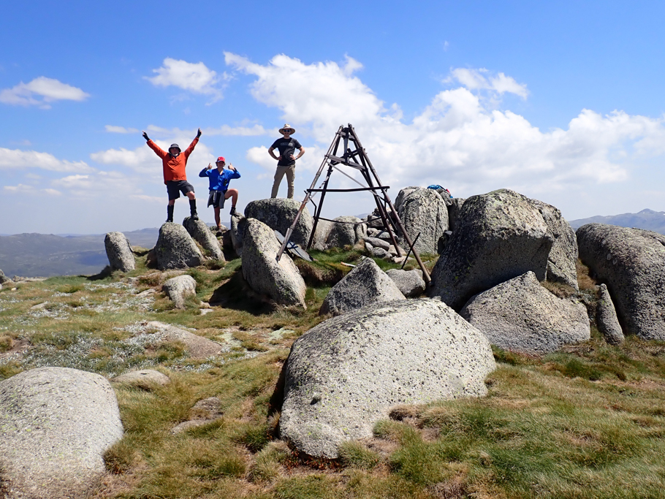

Venturer Scouts
Venturer Scouts is for young people aged 14–17 years. Venturer Scouts experience more independence and responsibility.
Venturer Scouts might get the chance to:
Tackle a multi-day hike
Become a youth leader for Joeys or Cubs
Discover passion for a new adventure like caving, mountain biking, kayaking or abseiling
Take on more responsibilities
Work towards your King’s Scout Award or Duke of Ed
Put your experiences towards real world qualifications!
Most Units meet weekly. The Unit’s activities are planned and run by the Venturers themselves – which means they are tailored to the requirements and interests of members.
<GROUP NAME> VENTURER SCOUTS
MONDAY 7-9PM
GROUP SCOUT HALL
OUR LEADERS ARE
DIESEL (MATT)
WALLABY (SARAH)

Slide 11
Add photos from your own group or unit here

Slide 12
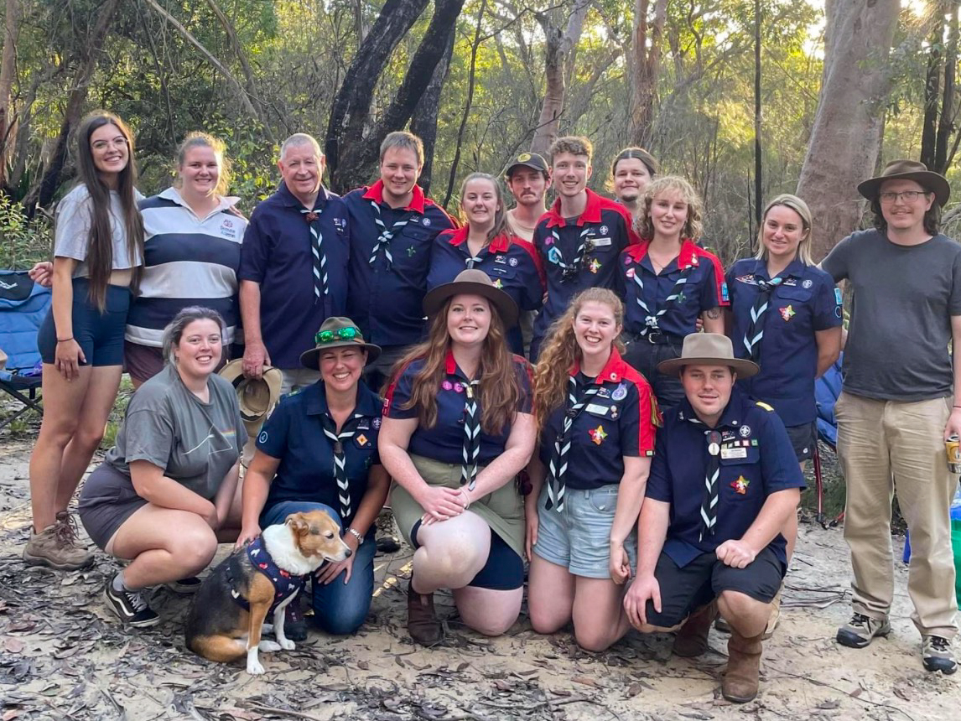

Rover Scouts
Rover Scouts welcome young adults from ages 18–25 years. You don’t need to have any Scouting experience, but you do need a can-do attitude!
Rover Scouts:
Are responsible for themselves and others
Specialise and expand their interests
Face challenging adventures
Explore global citizenship
Put your experiences towards real world qualifications!
Provide service to their fellow Scouts and wider community
Rover Scouts enjoy helping others, having a great time and taking on new challenges.
Each Rover Scout Unit is different, consisting of anywhere from a handful of members to 20 or more. Most Units meet weekly and a Unit's activities are planned and run by the Rovers themselves – which means they are tailored to the requirements and interests of members.
<GROUP NAME> ROVER SCOUTS
MONDAY 7-9PM
GROUP SCOUT HALL

Slide 13
Add photos from your own group or unit here

Slide 14
What exciting things are coming up?
Add a screenshot of your term program here, or list exciting things like Cuboree or Jamboree!

